Slide 1

Online Book Recommendation & Reading List Manager

Slide 2

Project Overview
This project provides a platform for users to manage their reading habits, track books, and receive personalized recommendations. It addresses the need for a structured system to improve reading engagement.

Slide 3





Core Functionality
Book Entry & User Input
DynamoDB Integration
Recommendation Engine
Store and manage book entries, supporting queries by genre, rating, and status.
Analyze reading history to suggest 3-5 personalized book recommendations.
Enter, validate, edit, and delete book details with unique IDs and tagging.
Reading List Tracker
Summary Dashboard & Reports
Manage planned and in-progress books, update status, and track progress.
Visualize reading stats, trends, and generate downloadable summaries.

Slide 4

Problem Statement
Many students struggle to manage their reading habits and find new books. Our platform offers a structured system to track read books, categorize them, and receive personalized suggestions based on interests and history, leveraging Python and AWS.

Slide 5
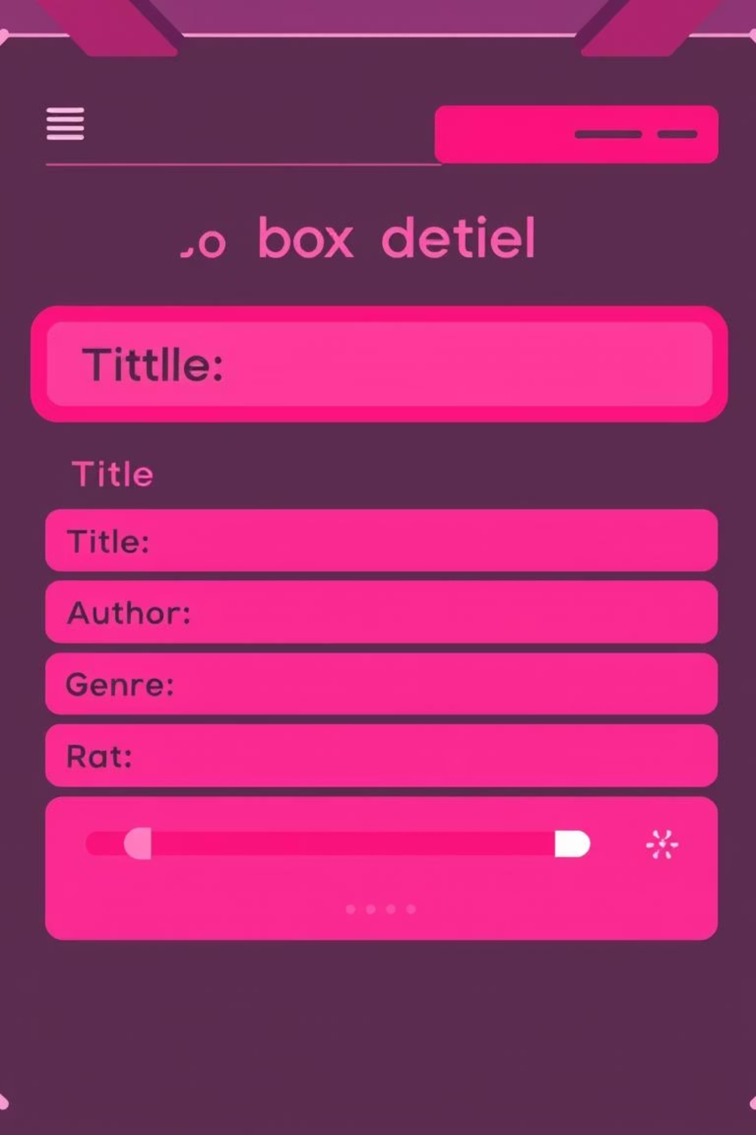
Module 1: Book Entry & User Input
This module allows users to enter book details such as title, author, genre, rating, and status (read/to-read). It validates inputs, prevents duplicates, assigns unique IDs, and supports edits/deletions and tagging for easy search and grouping.

Slide 6
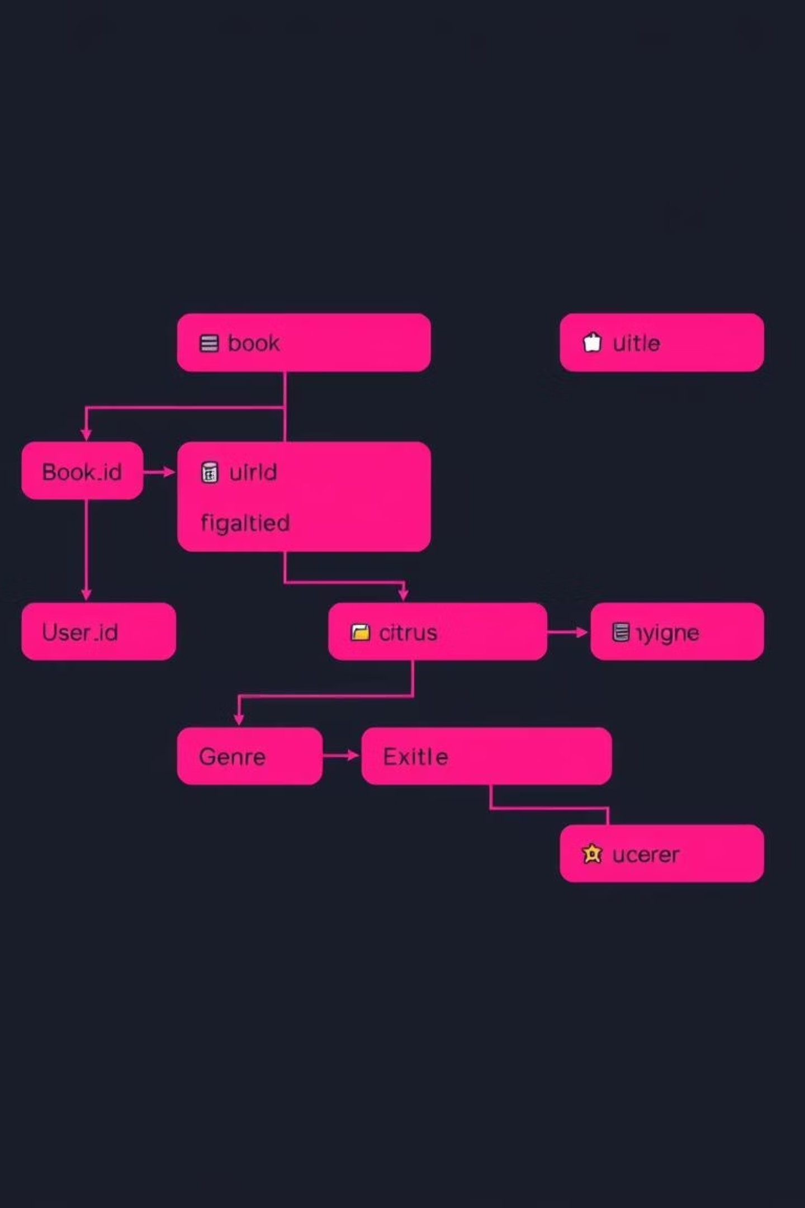
Module 2: DynamoDB Integration
We create a DynamoDB table to store book entries, including book_id, user_id, title, genre, rating, status, and timestamp. This module implements add, edit, delete, and search operations, supporting queries by genre, rating, and status, while maintaining user-specific reading history.

Slide 7

Module 3: Recommendation Engine
Triggered by new book additions or scheduled intervals, our Lambda-powered engine analyzes user's most-read genres and highly-rated books. It recommends similar books from a predefined dataset, filters out already-read books, and returns top 3-5 personalized suggestions.

Slide 8

Tools & Technologies
Programming Language
AWS Services
Libraries
Methodology
Lambda, DynamoDB
Boto3, Pandas, Streamlit (optional), Matplotlib
Agile (weekly sprints)
Python

Slide 9
Project Milestones
Setup Environment
1
Configure DynamoDB table and IAM roles (Week 1)
Input Module
2
Develop CLI or Web input for book entries (Week 2)
Recommendation Logic
3
Build Lambda to generate book suggestions (Week 3)
Reading Tracker
4
Implement progress updater and status management (Week 4)
Dashboard & Reports
5
Visualize reading stats, generate summary reports (Week 5)

Slide 10

Architecture Diagram & Sample Data
Architecture Flow
Sample Book Entry
Input (CLI/Web) → DynamoDB → Lambda (recommendation trigger) → Suggestions → Dashboard/Report
{ "book_id": "B1021", "user_id": "U1003", "title": "Atomic Habits", "genre": "Self-help", "rating": 5, "status": "Completed", "timestamp": "2025-06-01"}

